Slide 1

Department of Computer Science and Engineering CSIN: Internship
UG Internship Report
STUDENT’S NAME: Gaurav V
USN: 1MS18CS046
Academic Year: 2021 - 2022
Internship Period : Aug 9th 2021 – Nov 15th 2021, 3 Months
Supervisors : Mr. N. S. Srivathsa
MSRIT Mentor: Dr. Shilpa Shashikant Chaudhari

Slide 2
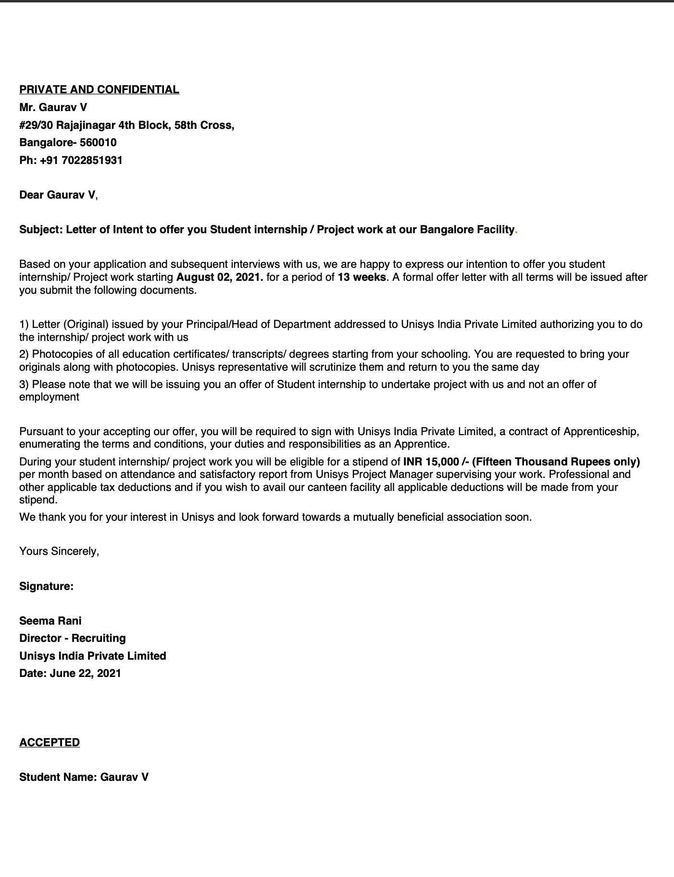
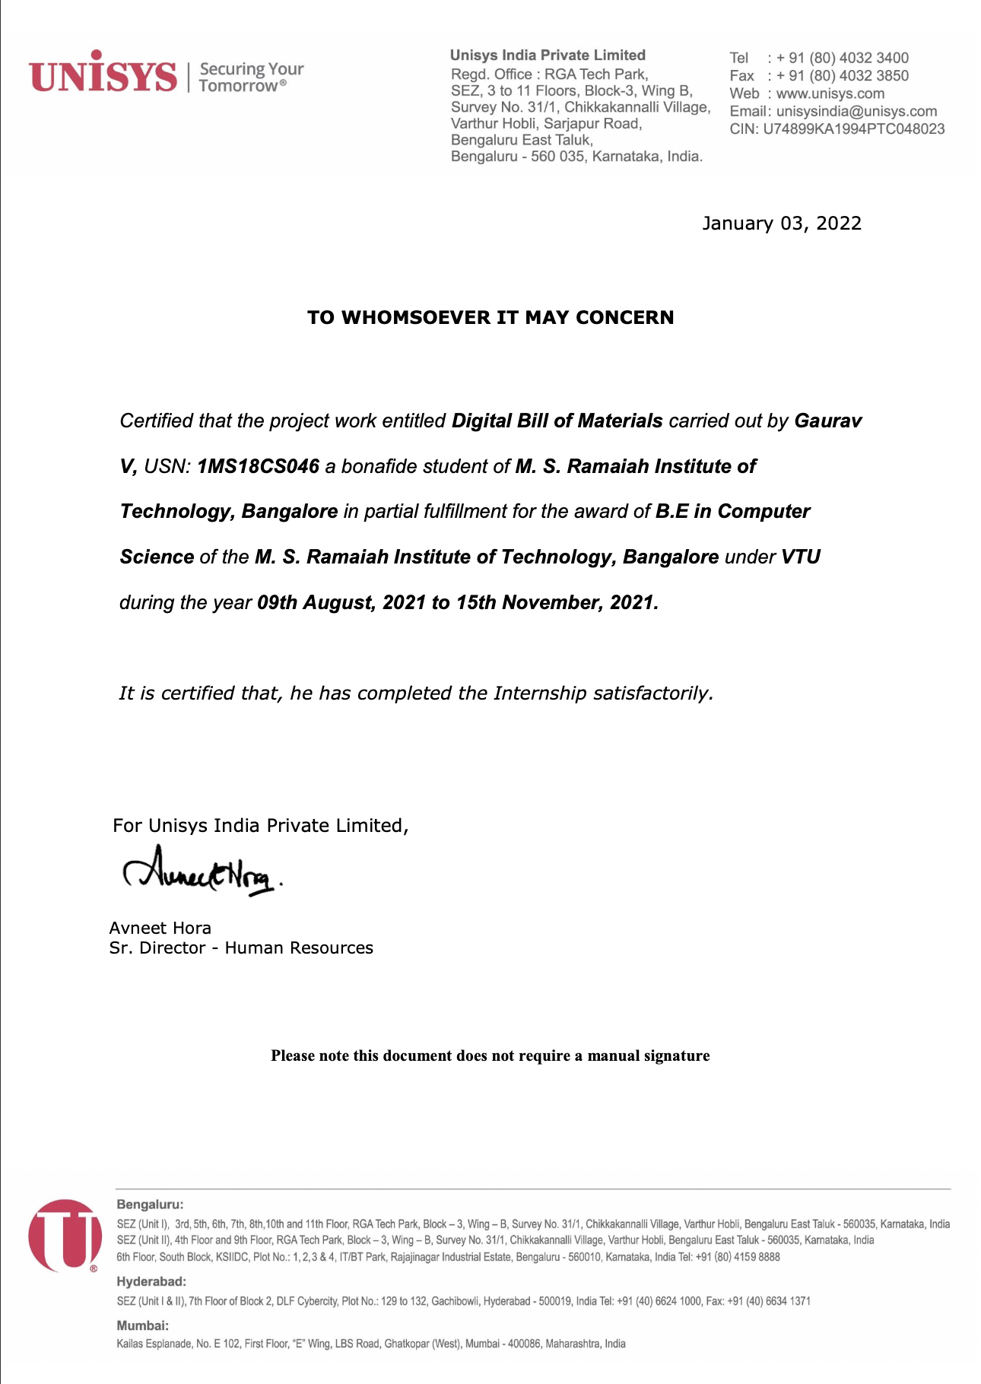
Offer and Completion Letter

Slide 3
Acknowledgement
First, I would like to thank Mr. N.S. Srivathsa, Senior Engineering Director, Unisys India Private Limited for giving me the opportunity to do an internship in their organization, and highly indebted for guiding and making me industry-ready.
I also would like to thank all the people who worked along with me at Unisys India Private Limited for their patience and openness. It is indeed with a great sense of pleasure and immense sense of gratitude that I acknowledge the help of these individuals.
I am thankful to Dr. N. V. R Naidu, Principal MSRIT for the facilities provided to accomplish this internship.
I would like to thank our Head of the Department Dr. Annapurna P. Patil for her constructive criticism throughout my internship.
I would like to thank Dr. S. Rajarajeswari, Department Internship coordinator, and my Internal supervisor Dr. Shilpa Shashikant Chaudhari for their support.
I am extremely grateful to my department staff members and friends who helped me in the successful completion of this internship.

Slide 4
Table of Contents
S.NO | Particulars | Page No.
1 | Offer Letter | 2
2 | Completion Certificate | 2
3 | Acknowledgement | 3
4 | Executive Summary | 5
5 | About the Company | 6
6 | About the Project | 7
7 | Opportunities | 10
8 | Learning | 11
9 | Challenges Faced | 12
10 | Implementation | 13
11 | References | 14

Slide 5
Executive Summary
My internship started on the 9th of August 2021. Once the onboarding formalities were complete, I was introduced to my manager and teammates. The project description and requirements were explained to me, and I was assigned with trainings and tasks to complete for the same.
The training courses assigned to me were the ones that would come handy when I worked on my project. Apart from the project specific trainings, I also attended the generic training track where topics like Payroll, Conversion procedures, and mandatory web content-based courses were explained in much detail.
The Digital Bill of Materials (DBoM) enables companies to easily establish a secure network for sharing software, hardware and manufacturing bill of materials. Organizations will be able to automate attestation sharing and validation for stablishing trust and transparency while reducing the cost of operation.
Internship ended on 15th November 2021, in the last week we worked on handing over the work and presenting the work to a larger team.

Slide 6
About the company – Unisys India Pvt Ltd
Unisys Corporation is an American multinational information technology (IT) services and consulting company headquartered in Blue Bell, Pennsylvania.
They have helped businesses and governments around the world by bringing technological innovation.
They offer vast number of services like outsourcing and managed services, systems integration and consulting services, high end server technology, cybersecurity and cloud management software, and maintenance and support services.
They also organize Cloud 20/20, which is an annual hackathon for students from all over India.
The company has evolved and adapted over time, but their passion for innovation and helping clients succeed has remained constant over the years.

Slide 7
About the Project - Digital Bill of Materials (DBoM)
Digital Bill of Materials (DBoM) enables companies to easily establish a secure network for sharing software, hardware and manufacturing bill of materials.
A Bill of Materials (BoM) is a list of everything on a pallet or box or unit of transport that moves from one set of hands to another. A Digital Bill of Materials is a list of every component inside any type of product as each moves from one set of hands to another.
Vision : Provide a common platform for managing supply chain information

Slide 8
About the Project - Digital Bill of Materials (DBoM)
Organizations will be able to automate attestation sharing and validation for stablishing trust and transparency while reducing the cost of operation
It is more than just sharing Bill Of Materials, as it can be used in various other use cases like:
Manufacturing
Compliance and regulatory requirements
Internal information Sharing
Creating a Digital BoM for a product is simply the act of signing a shared ledger at each step of production and consumption. With digital certificates establishing identity and a distributed ledger run by a consortium of large industry producers providing scale as well as nonrepudiation and forensic record keeping, each step of each physical and virtual product component can be documented with a high degree of surety.

Slide 9
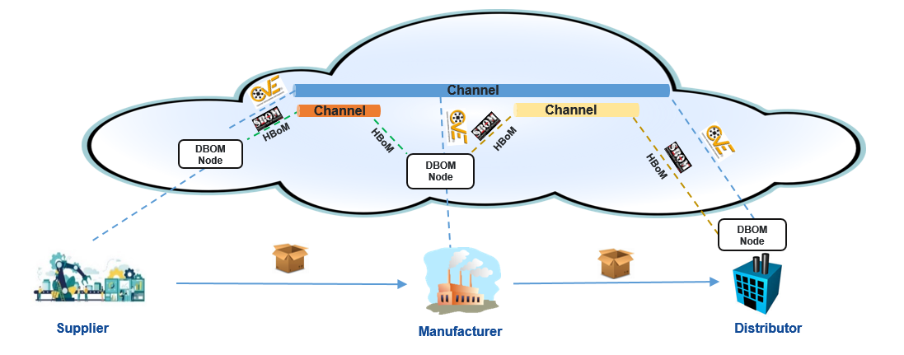
About the Project - Digital Bill of Materials (DBoM)
Fig 1. DBOM Architecture
Nodes are interfaces to process and store data in a standardized manner on Channels.
Channels allow organizations to implement controls on their value chain of shared data, in compliance with policy.

Slide 10
Opportunities
In the first month we got introduced to the team and got a brief description of the project, we had multiple inductions related to the company’s policies, values and organizational structure.
Along with the inductions we had multiple informatory sessions on technologies relevant to the project.
Once we got a grasp of the new technologies and understood the problem statement we started working on the project.
Initially we were given tasks on developing UI mockups.
Once that was completed, we started working on the frontend and backend simultaneously.
Daily standups were conducted to check the teams and personal progress.
At the end, the code was reviewed and handed over after multiple checks and iterations.

Slide 11
Learnings
Technical Skills
Learnt new frontend frameworks and tools like AngularJS and PrimeNG components.
Learnt new backend technologies like Golang, NodeJS, Swagger OpenAPI.
Also gained skills of using tools like Postman, Figma and a version control system like git.
Soft Skills
Communication skills by conversing with various professionals over the duration of 3 months in various contexts of the project and the organization.
Work experience that can be essential when transitioning into the technology industry.
Understood the essence and importance of teamwork in any professional setup and the major role it plays in the success of a project.

Slide 12
Challenges Faced
The learning curve is quite steep when transitioning into a workplace and I had to start quite slowly in the initial weeks but as time passed by, I was able to pick up pace and finish all assignments in the stipulated time frame.
The cultural differences between colleges and professional work environments are quite different. It sure takes time to understand the office culture. Since every organizational culture varies from office to office.
As digital bill of materials is a new concept it took meticulous effort to understand and develop the proof of concept.
Replicating Figma mock-ups to actual webpages took some time initially as AngularJS was a new web framework for me.

Slide 13
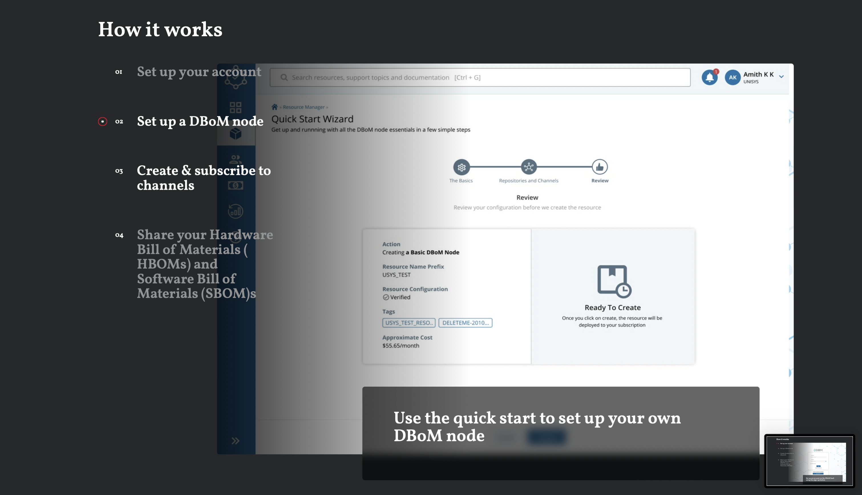
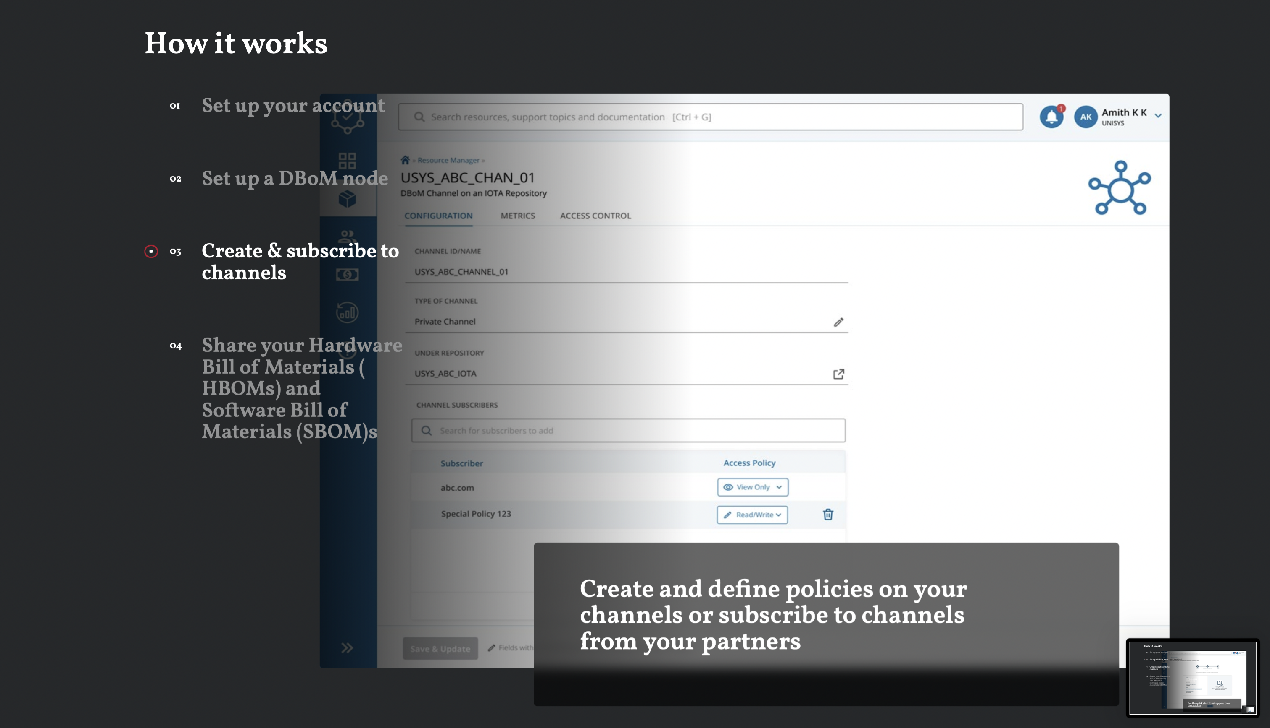
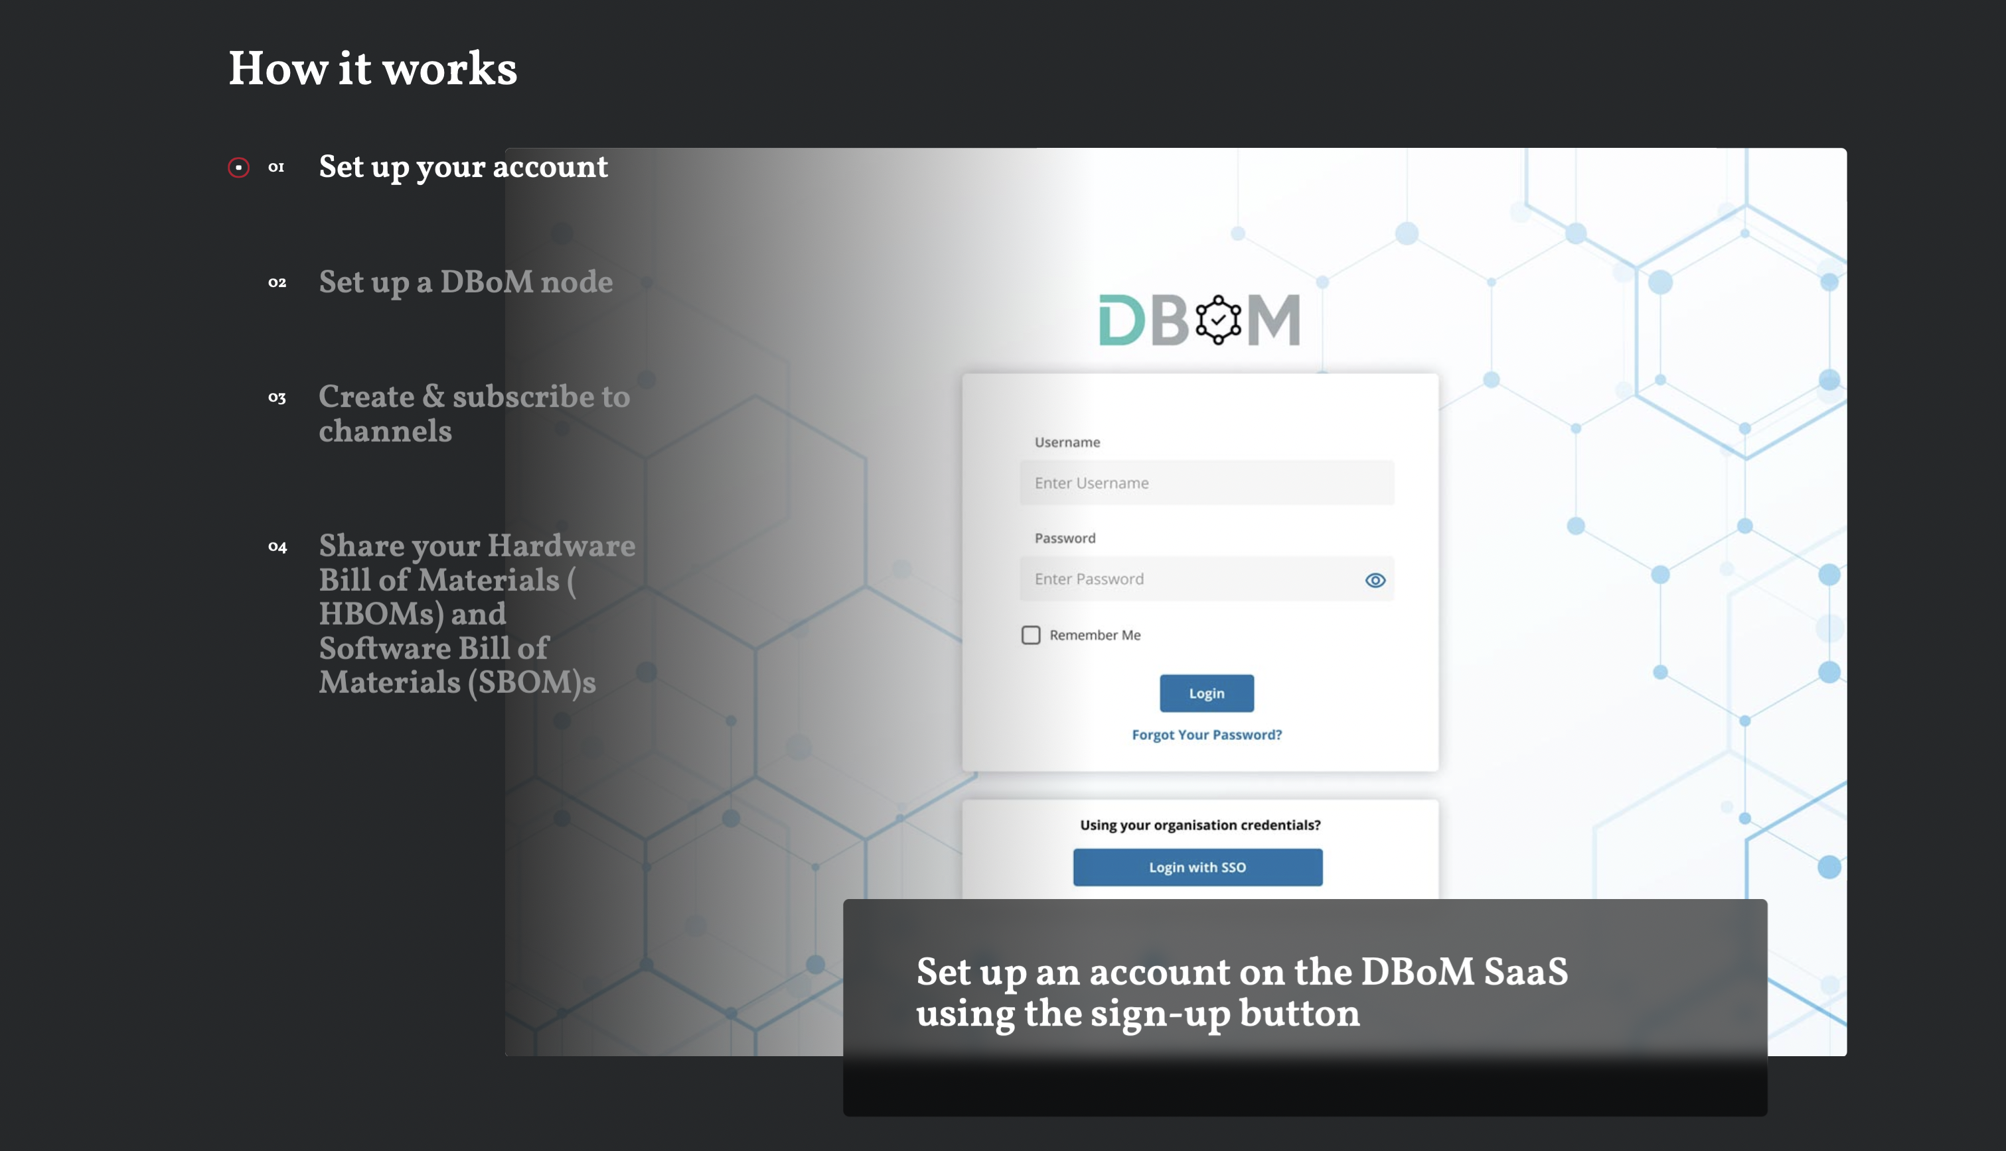
Implementation

Slide 14
References
https://www.unisys.com/dbom/
https://dbom-project.readthedocs.io/en/latest/
https://dbom-project.readthedocs.io/en/latest/use-cases.html
https://docs.angularjs.org/guide
https://go.dev/doc/
https://www.primefaces.org
https://www.mongodb.com/docs/
https://www.rsaconference.com/library/Presentation/USA/2021/dbom-and-sbom-new-options-for-better-supply-chain-cybersecurity
https://www.openbom.com/blog/bill-of-materials-what-is-a-digital-bom

